Slide 1
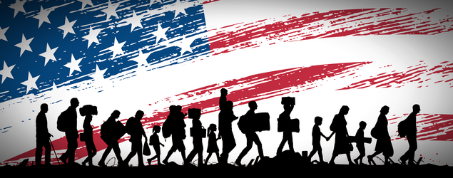
Image Credit: Ayn Rand Institute/ Seita via Shutterstock.com
How does America feel about immigration?
A DATA ANALYSIS ABOUT THE IMPACT OF IMMIGRATION IN THE AMERICAN ATTITUDES.
BY M. HASHER, J. MENDIOLA & R. ORR

Slide 2
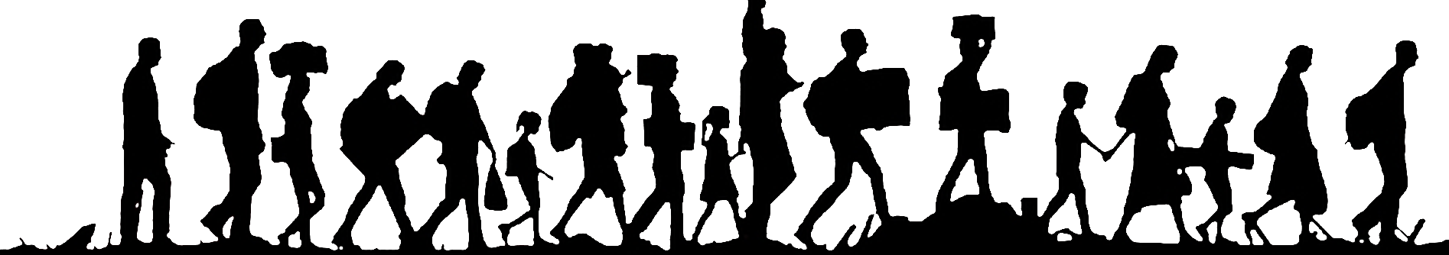

Questions to be asked
Is there a correlation between Twitter sentiment and immigration stock and/or flows?
Is hate crime correlated with immigration?
Are sanctuary cities safer than other cities in terms of hate crime?
How America feels about immigration?

Slide 3
Approach
Matching the Twitter accounts of local NPR news stations along with Twitter accounts of local television stations with counties.
Use the data obtained along with US Census data to evaluate the relationship between the sentiment of these news Tweets and their replies with foreign-born share of the population.
How America feels about immigration?

Slide 4





Data Sources
CENSUS DATA
CSV files:
FIPS Code List
Demographics
Sanctuary cities
Immigration Rates
CRIME DATA
MEDIA DATA
CSV files:
Hate Crime Data (2012-2016)
PDF files:
NPR Stations List
Media Data- CSV files: NPR Twitter handles and local television Twitter handles
APIs
Twitter API was used to search local NPR affiliates and TV station tweets by the following filters: “Immigration, immigrant, immigrants, foreigner, non-citizen, undocumented, non-citizen, ’permanent resident”. The API also allowed us to geo-locate the tweet.
Google Geolocation API was used to geo-locate the agencies included in the UCR Hate Crime Data Reports to be able to assign each agency name to their respective FIPS code.
How America feels about immigration?

Slide 5


Data Exploration & Cleanup
NOTEBOOKS
Hate Crime
Twitter
Census Information
Project Repository
How America feels about immigration?

Slide 6
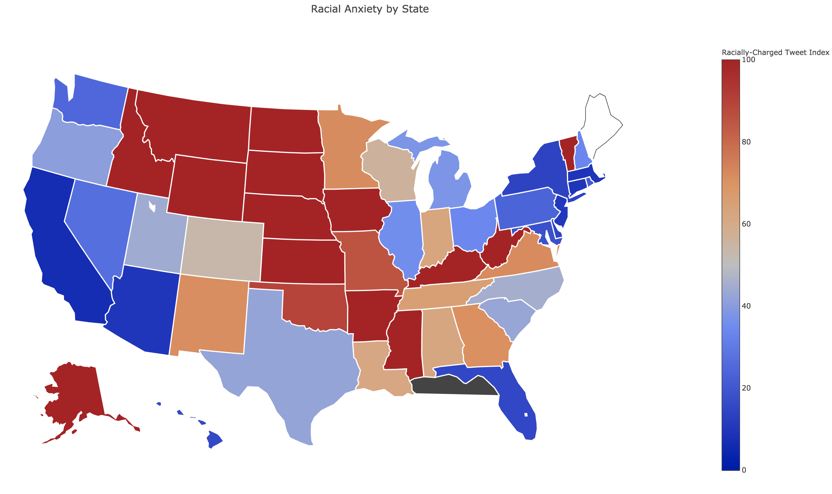
Data Analysis
Does Anti-Immigrant Sentiment Decline when individuals come into contact with Immigrants?
Text box text box
How America feels about immigration?

Slide 7
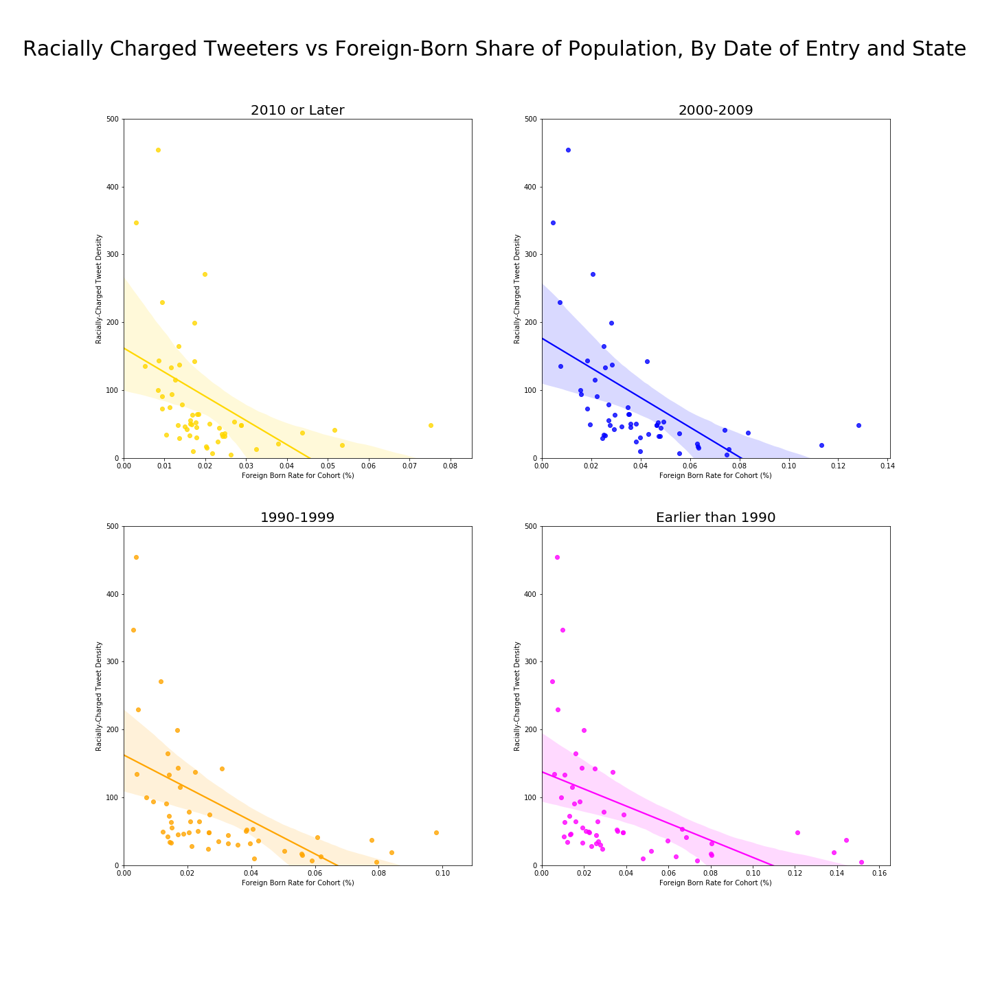
Data Analysis
Does Anti-Immigrant Sentiment Decline when individuals come into contact with Immigrants?
Text box text box
How America feels about immigration?

Slide 8
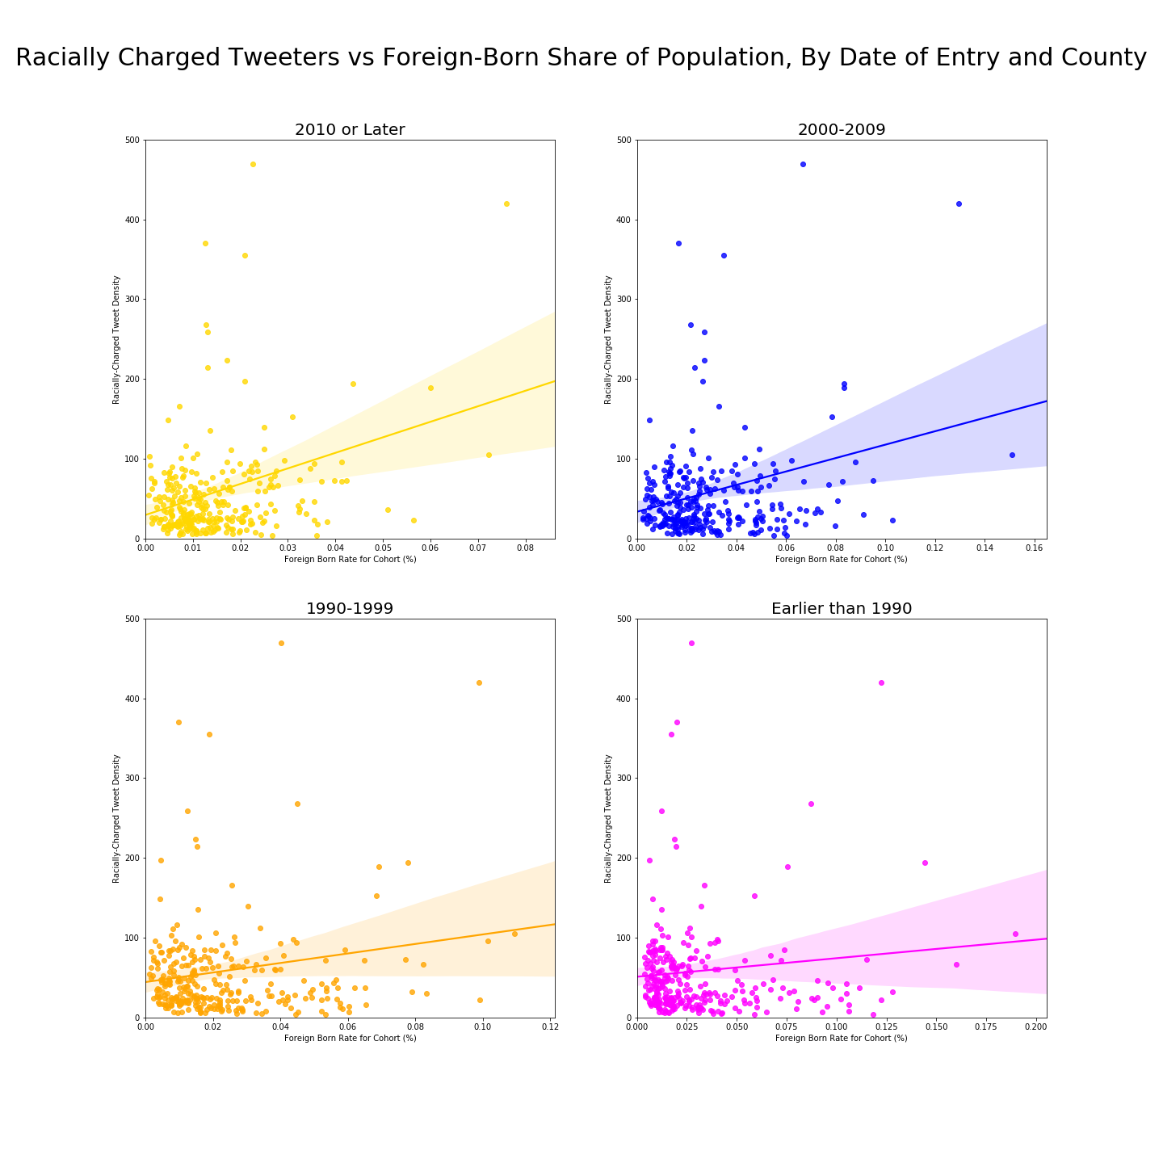
Data Analysis
Does Anti-Immigrant Sentiment Decline when individuals come into contact with Immigrants? Counties?
Text box text box
How America feels about immigration?

Slide 9
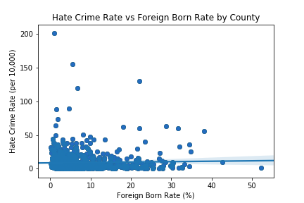
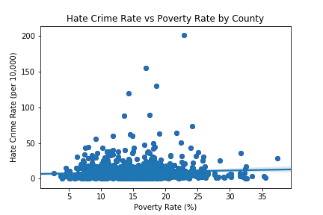
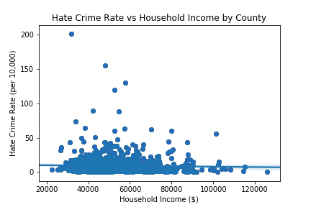
Data Analysis
Is there a correlation between hate crime and immigration?
Scatter plots were created to compare Hate Crime Rate with the following key demographic indicators:
Foreign Born Rate
Poverty Rate
Household Income
No significant correlation found.
How America feels about immigration?

Slide 10
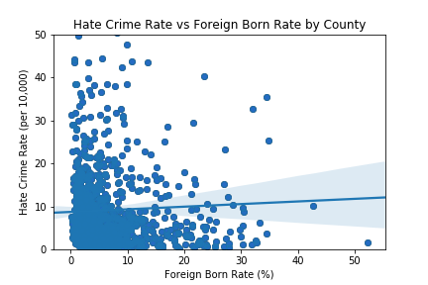
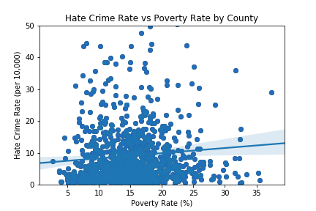
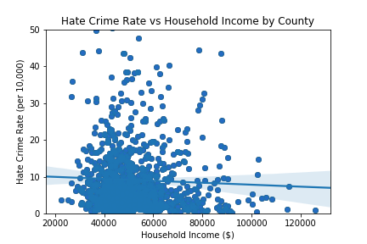
Data Analysis
Is there a correlation between hate crime and immigration?
Outliers were removed and plot zoomed to look for correlation among the indicators.
No significant correlation found.
How America feels about immigration?

Slide 11
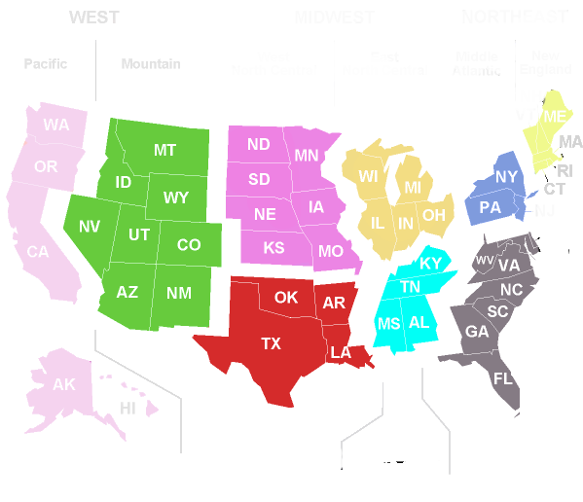
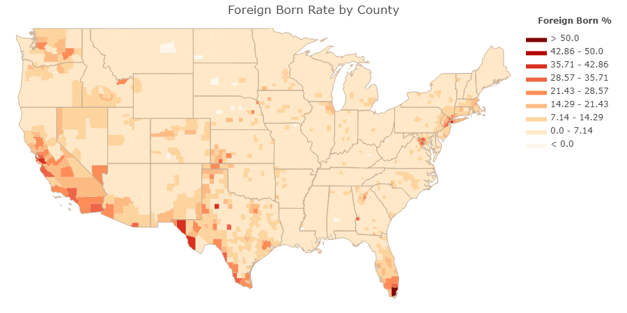
Data Analysis
Is there a correlation between hate crime and immigration?
Choropleth Map to measure Foreign Born Rate by County in 2016.
California, Texas, Florida, and New York are the states with higher foreign born rate by county.
How America feels about immigration?

Slide 12
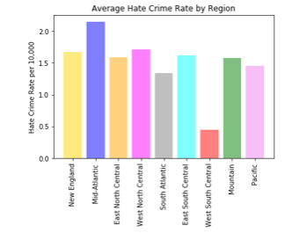
Is there a correlation between hate crime and immigration?
Data Analysis
Bar plot to measure the Average Hate Crime Rate by Region from 2012 to 2016.
How America feels about immigration?

Slide 13
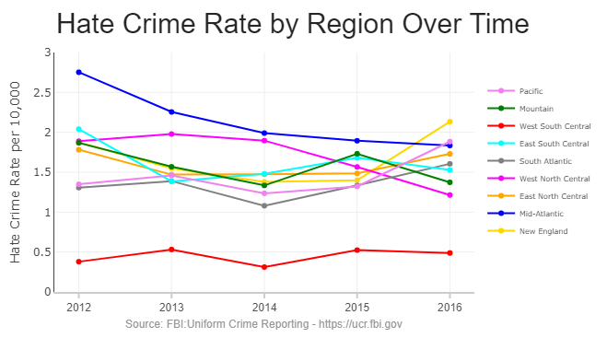
Data Analysis
Is there a correlation between hate crime and immigration?
Line plot to measure Hate Crime Rate over time by Region from 2012 to 2016.
New England, Pacific, South Atlantic and regions had a significant increase on the election year (2016).
How America feels about immigration?

Slide 14
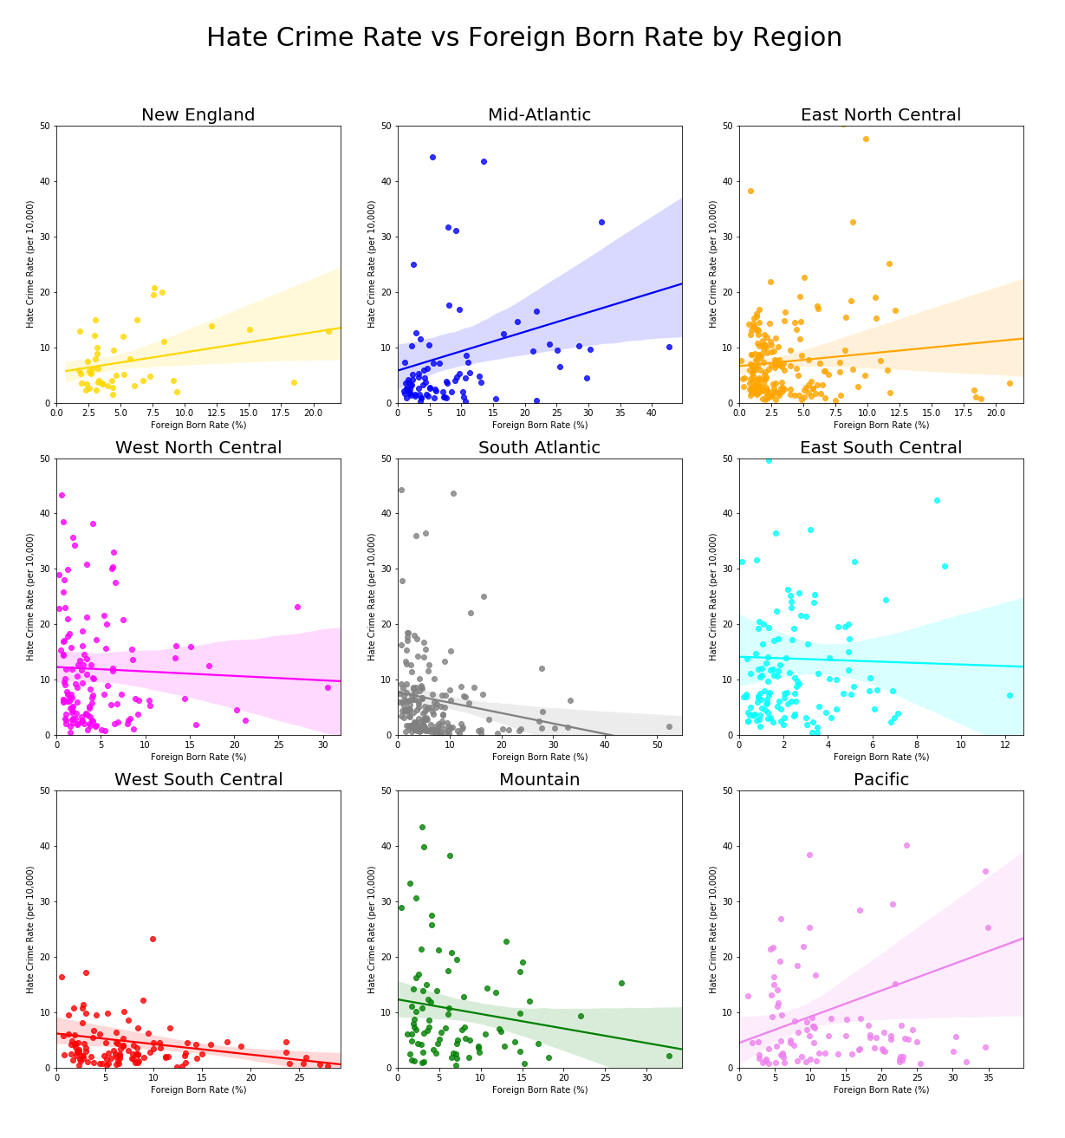
Data Analysis
Is there a correlation between hate crime and immigration?
HATE CRIME vs FOREIGN BORN RATE
Scatter plots created to analyze behavior differences among US regions.
How America feels about immigration?

Slide 15
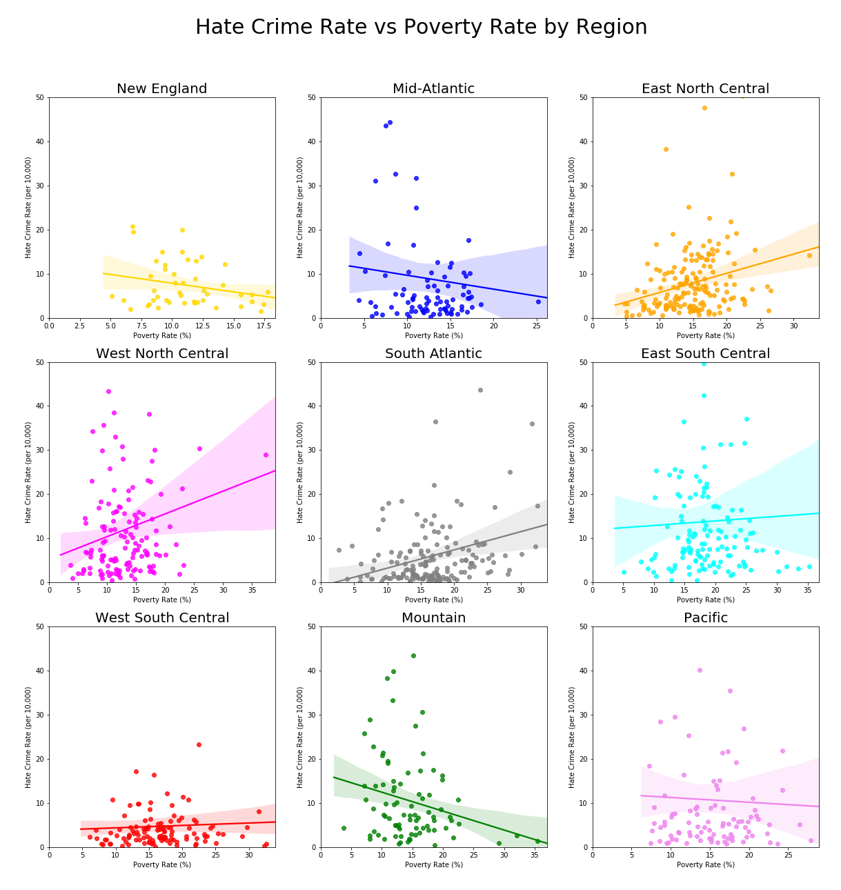
Data Analysis
Is there a correlation between hate crime and immigration?
HATE CRIME vs POVERTY RATE
Scatter plots created to analyze behavior differences among US regions.
How America feels about immigration?

Slide 16
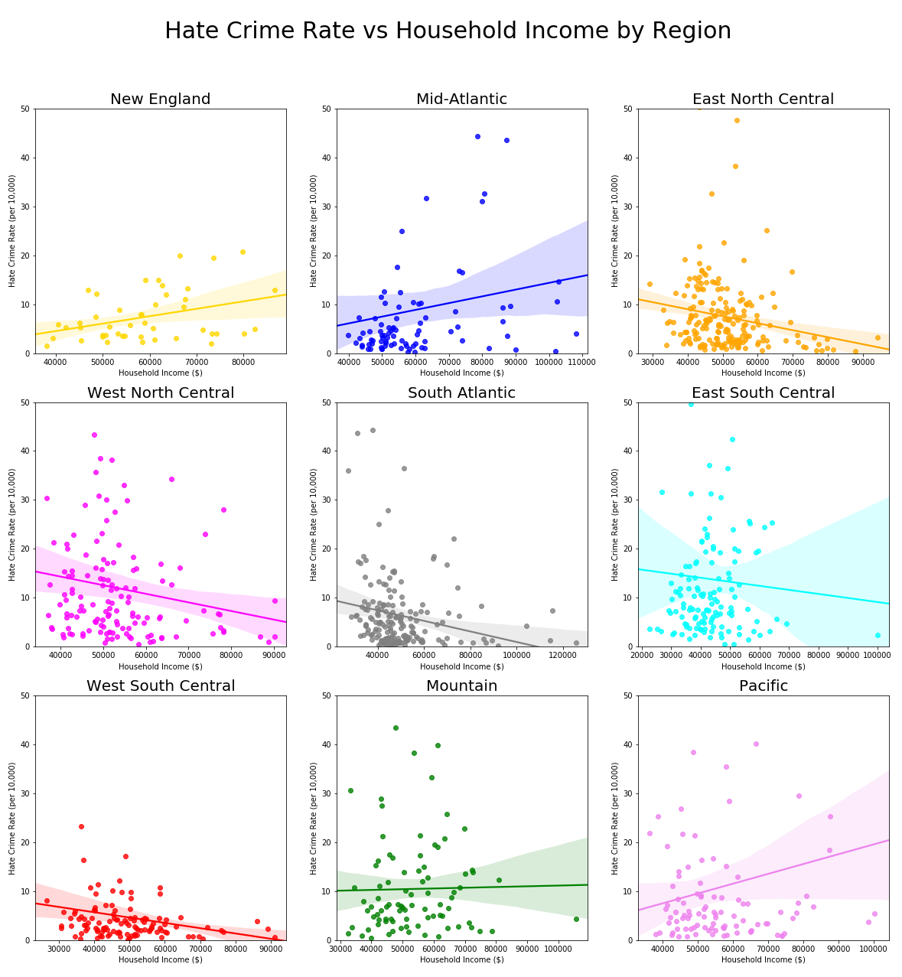
Data Analysis
Is there a correlation between hate crime and immigration?
HATE CRIME vs HOUSEHOLD INCOME
Scatter plots created to analyze behavior differences among US regions.
How America feels about immigration?

Slide 17
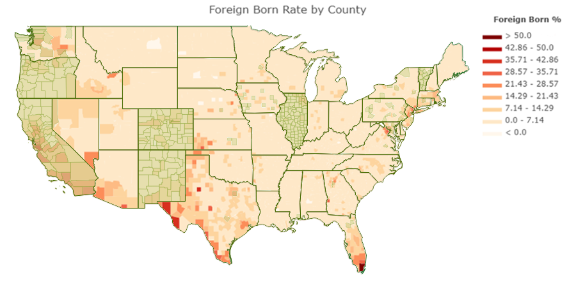
Data Analysis
Are sanctuary cities safer than other cities in terms of hate crime ?
Choropleth Map to measure Foreign Born Rate by County in 2016.
California, Texas, Florida, and New York are the states with higher foreign born rate by county.
How America feels about immigration?

Slide 18
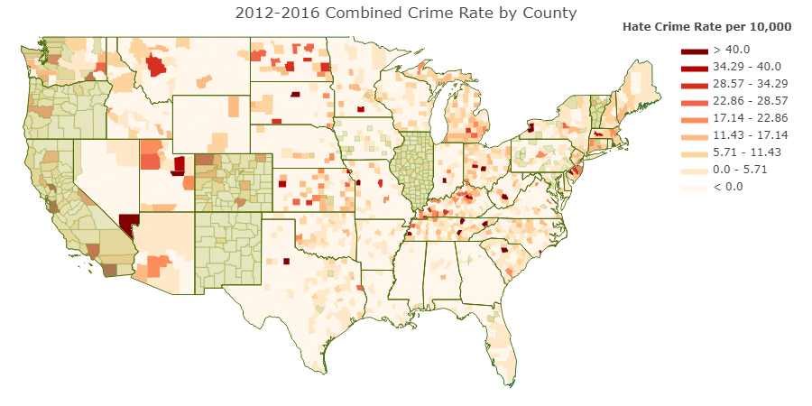
Data Analysis
Are sanctuary cities safer than other cities in terms of hate crime ?
Choropleth Map to measure combined Hate Crime Rate by County (2012-2016) with sanctuary cities overlapped in green.
It doesn’t seem to be a significant trend that relates sanctuary cities with a higher or lower hate crime rate in comparison with non-sanctuary cities.
How America feels about immigration?

Slide 19
Conclusions
So what took so long?
Using Twitter’s Geotags of Recent Searches
(Not enough data)
Search respondent’s sentiment towards local NPR stories on immigration
~700 NPR Twitter Handles Entered Manually
(Not Supported/ Not enough data)
Use sentiment of broadcasters themselves regarding immigration?
~500 more NPR Twitter Handles Entered Manually
Combined with ~600 local TV Station Handles
(Not enough data)
George Washington Professor Collected 16 Million Tweets on immigration from the week of the Travel Ban Executive Order
~140 hours later…
5. Crimson Hexagon (Thank you Ed Ali)
How America feels about immigration?

Slide 20
Conclusions
Is there a correlation between hate crime and immigration?
Based in our data analysis, it does not seem to be a correlation between hate crime and immigration.
Some regions show a significant increase in hate crime rate in 2016.
Mid-Atlantic region is showing a consistent decrease in hate crime rate since 2012.
West South Central region shows a particular low crime rate in comparison to other regions.
Are sanctuary cities safer than other cities in terms of hate crime ?
It doesn’t seem to be a significant trend that relates sanctuary cities with a higher or lower hate crime rate in comparison with non-sanctuary cities.
California is a sanctuary state with a high hate crime rate.
Utah is a non-sanctuary state with a high hate crime rate.
New Mexico is a sanctuary state with a low hate crime rate.
Texas is a non-sanctuary state with a low hate crime rate.
How America feels about immigration?

Slide 21
Data Limitations & Considerations
DATA LOSS
Some data had to be removed from dataframes due to incorrect/invalid information in one or more of its columns or because registered location was not found during the geo-location process.
DATA COLLECTION
Sanctuary cities are more likely to get reports about potential hate crimes by foreign born people (including illegal immigrants) due to the protection provided by the law about not being asked for their migration status.
Sanctuary cities are more likely to get crimes classified as hate crime report due to the awareness among population and police agencies about the subject. As stated in a 2017 CNN article, there are police agencies that do not disclose or collect hate crime data.
“The FBI reports that the numbers of hate crimes have decreased over several years, with the exception of 2015. Regardless of the year, however, the hate crime count is underreported to the FBI, explained Stacy. Some state, city and local police agencies simply don't collect or disclose the data.”
Middlebrook, H, 2017. The fascinating, if unreliable, history of hate crime tracking in the US. CNN, [Online]. Available at: https://www.cnn.com/2017/01/05/health/hate-crimes-tracking-history-fbi/index.html [Accessed 23 April 2018].
How America feels about immigration?

Slide 22
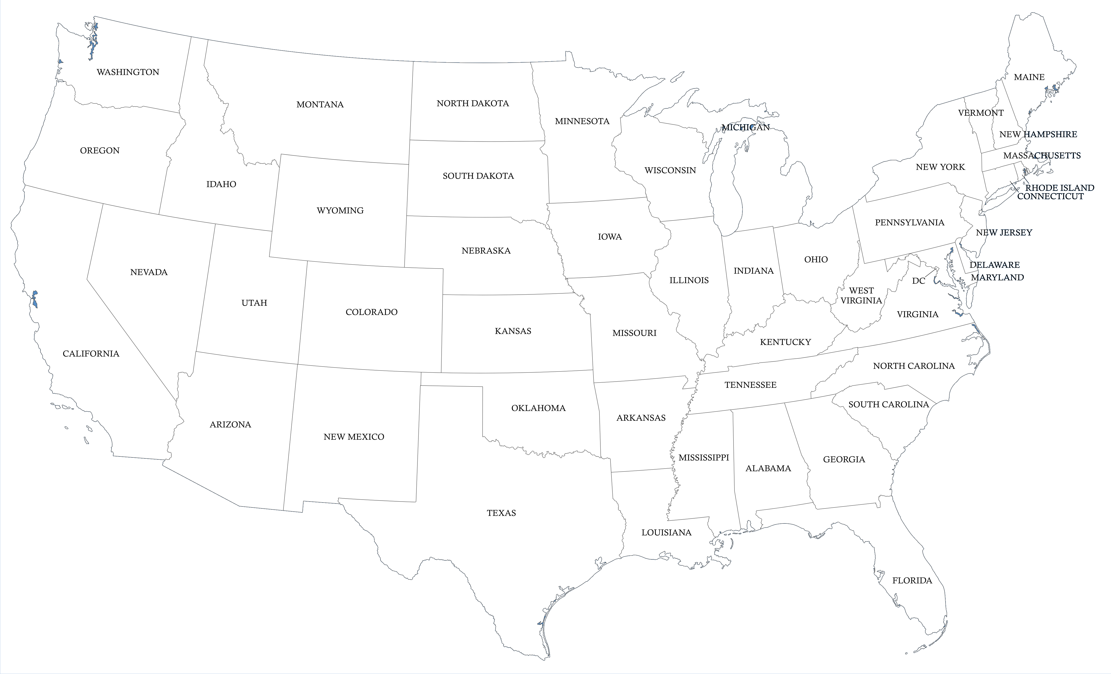
Thank you

